Slide 1
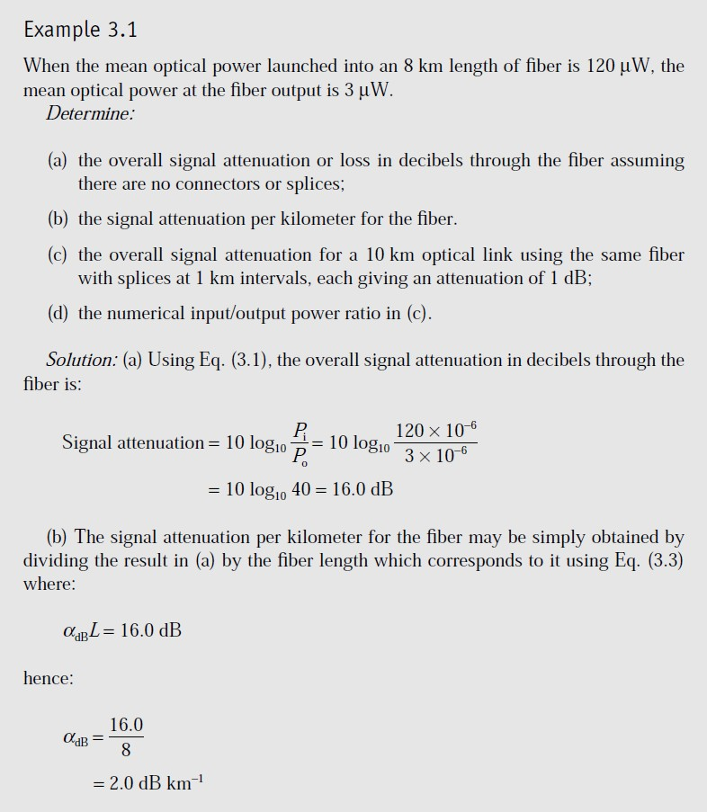
CHPTER THREE
Lecture(5)
3-1 Transmission characteristics of optical fibers[1]: Attenuation
Signal attenuation within optical fibers, as with metallic conductors, is usually expressed in the logarithmic unit of the decibel. The decibel, which is used for comparing two power levels, may be defined for a particular optical wavelength as the ratio of the input (transmitted) optical power Pin into a fiber to the output (received) optical power Pout from the fiber as[1]:
Number of decibels (dB) = 10 log10 ^{𝑷𝒊𝒏} (3.1)
𝑷𝒐𝒖𝒕
The addition and subtraction require a conversion to numerical values which may be obtained using the relationship[1]:
^{𝑷}𝒊𝒏
𝒅𝑩
= 𝟏𝟎𝟏𝟎 (𝟑. 𝟐)
^{𝑷}𝒐𝒖𝒕
In optical fiber communications the attenuation is usually expressed in decibels per unit length (i.e. dB km⁻¹) following:
αdBL = 10 log10 ^{𝑷𝒊𝒏}
(3.3)
Where αdB is the signal attenuation per unit length in decibels which is also referred to as the fiber loss parameter and L is the fiber length[1].
𝑷𝒐𝒖𝒕

Slide 2
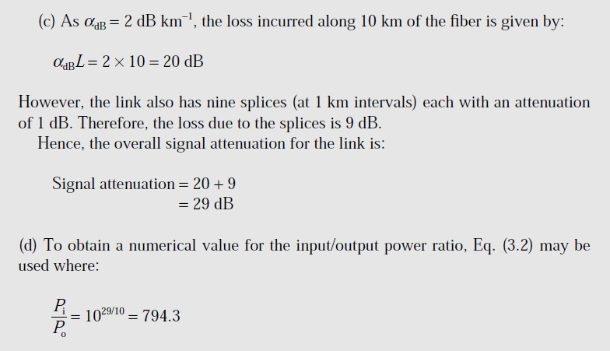
A number of mechanisms are responsible for the signal attenuation within optical fibers. These mechanisms are influenced by the material composition, the preparation and purification technique, and the waveguide structure. They may be categorized within several major areas which include material absorption, material scattering (linear and nonlinear scattering), curve and micro bending losses[1].
3.2 Material absorption losses in silica glass fibers
Material absorption is a loss mechanism related to the material composition and the fabrication process for the fiber, which results in the dissipation of some of the transmitted optical power as heat in the waveguide. The absorption of the light may be intrinsic (caused by the interaction with one or more of the major components of the glass) or extrinsic (caused by impurities within the glass)[1].
1- Intrinsic absorption:
An absolutely pure silicate glass has little intrinsic absorption due to its basic material structure in the near-infrared region. However, it does have two major intrinsic absorption mechanisms at optical wavelengths which leave a low intrinsic absorption window over the 0.8 to 1.7 μm wavelength range, as illustrated in Fig. 3.1, which

Slide 3
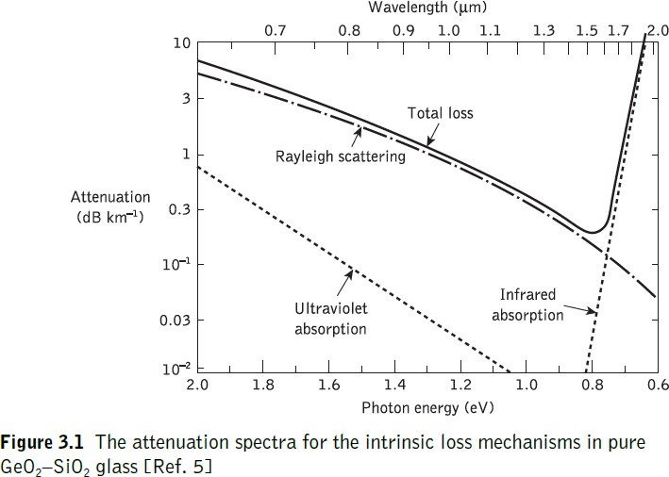
shows a possible optical attenuation against wavelength characteristic for absolutely pure glass. It may be observed that there is a fundamental absorption edge, the peaks of which are centered in the ultraviolet wavelength region. This is due to the stimulation of electron transitions within the glass by higher energy excitations. The tail of this peak may extend into the window region at the shorter wavelengths, as illustrated in Figure 3.1. Also in the infrared and far infrared, normally at wavelengths above 7 μm, fundamentals of absorption bands from the interaction of photons with molecular vibrations within the glass occur. These give absorption peaks which again extend into the window region.. Hence, above 1.5 μm the tails of these largely far- infrared absorption peaks tend to cause most of the pure glass losses[1].
However, the effects of both these processes may be minimized by suitable choice of
both core and cladding compositions. For instance, in some nonoxide glasses such as fluorides and chlorides, the infrared absorption peaks occur at much longer wavelengths which are well into the far infrared (up to 50 μm), giving less attenuation to longer wavelength transmission compared with oxide glasses[1].
2- Extrinsic absorption:
In practical optical fibers prepared by conventional melting techniques, a major
source of signal attenuation is extrinsic absorption from: (a) Transition metal element
impurities. Some of the more common metallic impurities found in glasses are shown in the Table 3.1, together with the absorption losses caused by one part in 10⁹ [1].

Slide 4
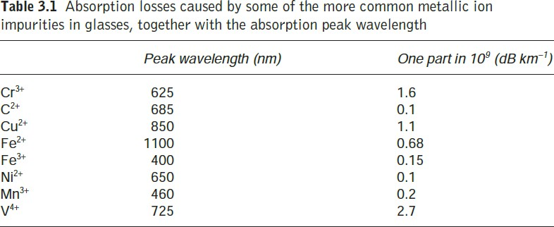
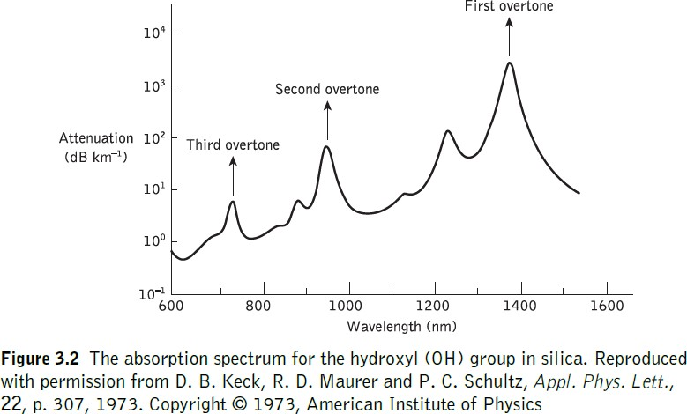
Transition element contamination may be reduced to acceptable levels (i.e. one part in 10¹⁰) by glass refining techniques such as vapor-phase oxidation , which largely eliminates the effects of these metallic impurities[1].
(b) Another major extrinsic loss mechanism is caused by absorption due to water (as the hydroxyl or OH ion) dissolved in the glass[1].
It may also be observed in Figure 3.2 that the only significant absorption band in the region below a wavelength of 1 μm is the second overtone at 0.95 μm which causes attenuation of about 1 dB km−1 for one part per million (ppm) of hydroxyl. At longer wavelengths the first overtone at 1.383 μm and its sideband at 1.24 μm are strong absorbers giving attenuation of about 2 dB km−1 ppm and 4 dB km−1 ppm respectively. Since most resonances are sharply peaked, narrow windows exist in the longer wavelength region around 1.31 and 1.55 μm which are essentially unaffected by OH absorption [1].

Slide 5
Lecture(6)
Linear scattering losses:
Linear scattering mechanisms cause the transfer of some or all of the optical power contained within one propagating mode to be transferred linearly (proportionally to the mode power) into a different mode. This process tends to result in attenuation of the transmitted light as the transfer may be to a leaky or radiation mode which does not continue to propagate within the fiber core, but is radiated from the fiber. It must be noted that as with all linear processes, there is no change of frequency on scattering. It classified into two major types[1]:
1. Rayleigh scattering
Rayleigh scattering is the dominant intrinsic loss mechanism in the low-absorption window between the ultraviolet and infrared absorption tails. It results from in homogeneities of a random nature occurring on a small scale compared with the wavelength of the light. These in homogeneities manifest themselves as refractive index fluctuations and arise from density and compositional variations which are frozen into the glass lattice on cooling. The compositional variations may be reduced by improved fabrication, but the index fluctuations caused by the freezing-in of density in homogeneities are fundamental and cannot be avoided[1].
𝜸_{𝑹} =
𝟖𝝅^{𝟑}𝒏^{𝟖}𝑷^{𝟐}𝜷_{𝑪}𝑲𝑻_{𝑭}
(𝟑. 𝟒)
𝟑𝝀^{𝟒}
where γR is the Rayleigh scattering coefficient, λ is the optical wavelength, n is the refractive index of the medium, p is the average photoelastic coefficient, βc is the
isothermal compressibility at a fictive temperature TF, and K is Boltzmann’s constant. The fictive temperature is defined as the temperature at which the glass can reach a state of thermal equilibrium and is closely related to the anneal temperature. Furthermore, the Rayleigh scattering coefficient is related to the transmission loss factor (transmissivity) of the fiber £ following the relation[1]:
£ = exp(−γRL) (3.5)
where L is the length of the fiber.

Slide 6
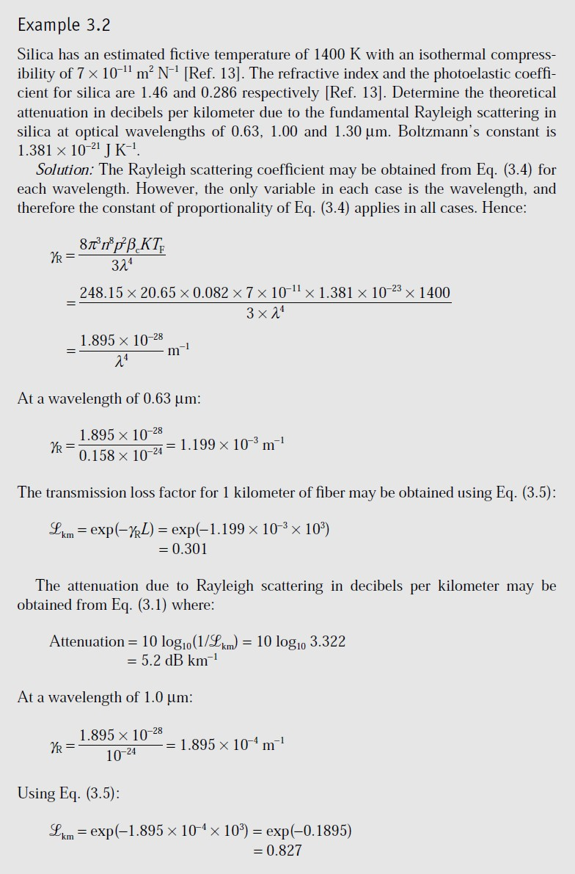

Slide 7
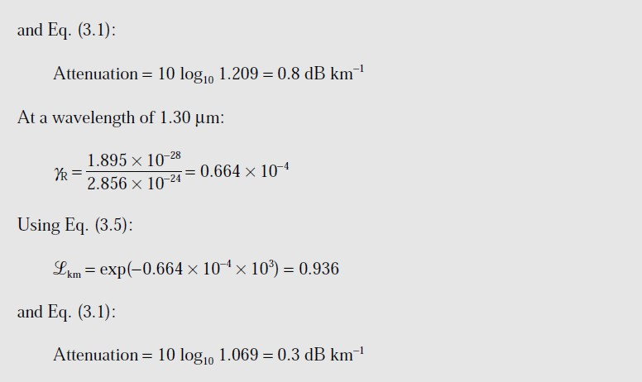
2 . Mie scattering
Linear scattering may also occur at in homogeneities which are comparable in size
with the guided wavelength. These result from the non perfect cylindrical structure of
the waveguide and may be caused by fiber imperfections such as irregularities in the core–cladding interface, core–cladding refractive index differences along the fiber length, diameter fluctuations, strains and bubbles. Depending upon the fiber material, design and manufacture, Mie scattering can cause significant losses. The in homogeneities may be reduced by[1]:
removing imperfections due to the glass manufacturing process;
carefully controlled extrusion and coating of the fiber;
increasing the fiber guidance by increasing the relative refractive index difference. By these means it is possible to reduce Mie scattering to insignificant levels.
Nonlinear scattering losses
Optical waveguides do not always behave as completely linear channels whose increase in output optical power is directly proportional to the input optical power. Several nonlinear effects occur, which in the case of scattering cause disproportionate attenuation, usually at high optical power levels. This nonlinear scattering causes the optical power from one mode to be transferred in either the forward or backward direction to the same, or other modes, at a different frequency. The most important

Slide 8
types of nonlinear scattering within optical fibers are stimulated Brillouin and Raman scattering, both of which are usually only observed at high optical power densities in long single-mode fibers[1].
1. Stimulated Brillouin scattering
Stimulated Brillouin scattering (SBS) may be regarded as the modulation of light through thermal molecular vibrations within the fiber. The scattered light appears as upper and lower sidebands which are separated from the incident light by the modulation frequency. The incident photon in this scattering process produces a phonon* of acoustic frequency as well as a scattered photon. This produces an optical frequency shift which varies with the scattering angle because the frequency of the sound wave varies with acoustic wavelength. The frequency shift is a maximum in the backward direction, reducing to zero in the forward direction, making SBS a mainly backward process. As indicated previously, Brillouin scattering is only significant above a threshold power density. The threshold power PB is given by[1]:
PB = 4.4 × 10⁻³d² λ² αdBν watts (3.6)
where d and λ are the fiber core diameter and the operating wavelength, respectively, both measured in micrometers, αdB is the fiber attenuation in decibels per kilometer and ν is the source bandwidth (i.e. injection laser) in gigahertz. The expression given in Eq. (3.6) allows the determination of the threshold optical power which must be launched into a single-mode optical fiber before SBS occurs[1].
2. Stimulated Raman scattering
Stimulated Raman scattering (SRS) is similar to SBS except that a high-frequency optical phonon rather than an acoustic phonon is generated in the scattering process. Also, SRS can occur in both the forward and backward directions in an optical fiber, and may have an optical power threshold of up to three orders of magnitude higher than the Brillouin threshold in a particular fiber. Using the same criteria as those specified for the Brillouin scattering threshold given in Eq. (3.6), it may be shown that the threshold optical power for SRS PR in a long single-mode fiber is given by[1]:
PR = 5.9 × 10⁻² d² λ αdB watts (3.7)
where d, λ and αdB are as specified for Eq. (3.6).

Slide 9
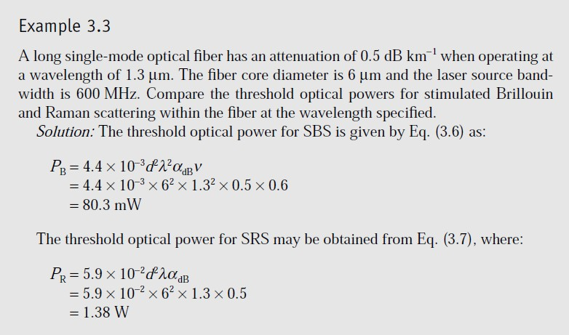
In Example 3.3, the Brillouin threshold occurs at an optical power level of around 80 mW while the Raman threshold is approximately 17 times larger. It is therefore apparent that the losses introduced by nonlinear scattering may be avoided by use of a suitable optical signal level (i.e. working below the threshold optical powers)[1].
Fiber bend loss
Optical fibers suffer radiation losses at bends or curves on their paths. This is due to
the energy in the evanescent field at the bend exceeding the velocity of light in the
cladding and hence the guidance mechanism is inhibited, which causes light energy to be radiated from the fiber. An illustration of this situation is shown in Figure 3.5. The part of the mode which is on the outside of the bend is required to travel faster than that on the inside so that a wave front perpendicular to the direction of propagation is maintained. Hence, part of the mode in the cladding needs to travel faster than the velocity of light in that medium. As this is not possible, the energy associated with this part of the mode is lost through radiation. The loss can generally be represented by a radiation attenuation coefficient which has the form[1].
αr = c1 exp(−c2R) (3.8)
where R is the radius of curvature of the fiber bend and c1, c2 are constants which are independent of R. The critical radius of curvature Rc which may be estimated from

Slide 10
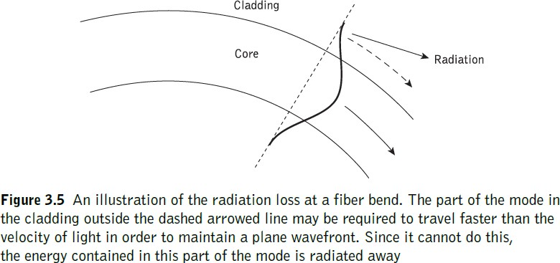
≈ 𝟏
𝑹
𝑪
𝟑𝒏^{𝟐}𝝀
𝟑
(3.9)
𝟒𝝅(𝒏^{𝟐}−𝒏^{𝟐})^{𝟐}
𝟏 𝟐
The expression of critical radius of curvature for a single-mode fiber Rcs can be estimated as:
𝑹_{𝑪𝑺} ≈
𝟐𝟎𝝀 𝝀
−𝟑
𝟑
(𝟐. 𝟕𝟒𝟖 − 𝟎. 𝟗𝟗𝟔 )
𝟑. 𝟏𝟎
(𝒏^{𝟐} − 𝒏^{𝟐})^{𝟐}
𝝀
𝑪
𝟏 𝟐
where λc is the cutoff wavelength for the single-mode fiber. It may be observed from the expression given in Eqs. (3.9) and (3.10) that potential macro bending losses may be reduced by[1]:
designing fibers with large relative refractive index differences;
operating at the shortest wavelength possible.

Slide 11
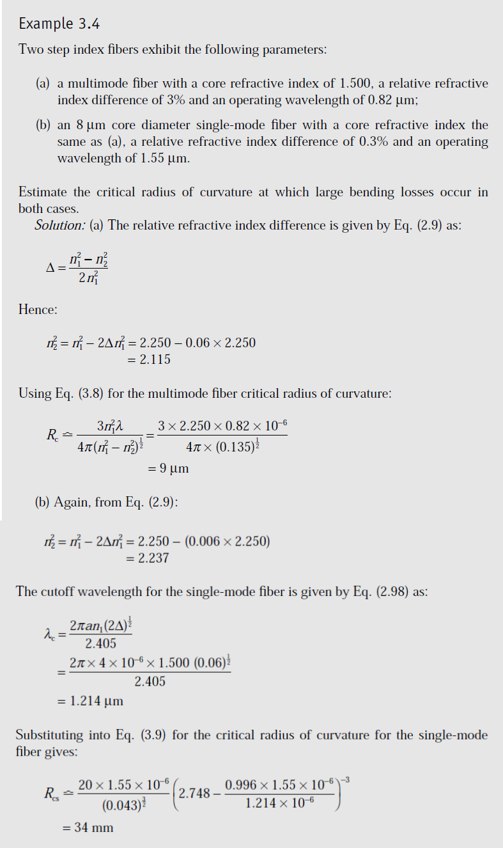

Slide 12
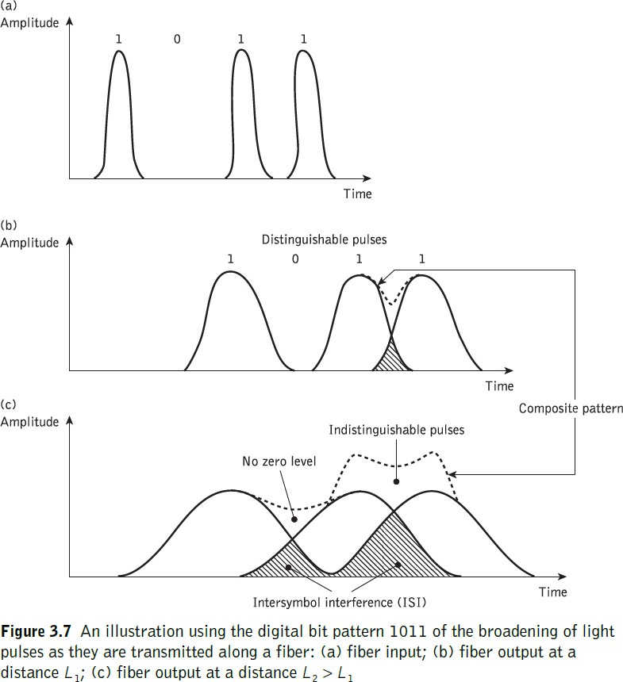
Lecture(7)
Dispersion
Dispersion of the transmitted optical signal causes distortion for both digital and analog transmission along optical fibers. When considering the major implementation of optical fiber transmission which involves some form of digital modulation, then dispersion mechanisms within the fiber cause broadening of the transmitted light pulses as they travel along the channel. The phenomenon is illustrated in Figure 3.7, where it may be observed that each pulse broadens and overlaps with its neighbors, eventually becoming indistinguishable at the receiver input. The effect is known as intersymbol interference (ISI) [1].

Slide 13
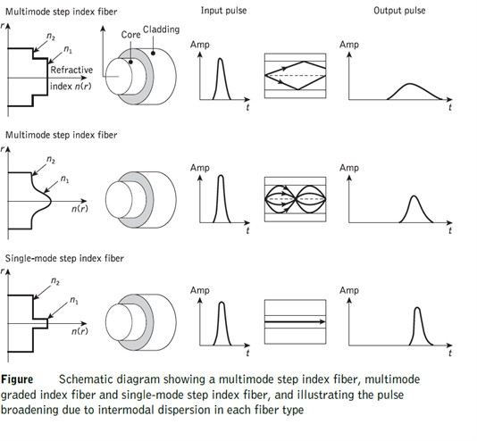
For no overlapping of light pulses down on an optical fiber link the digital bit rate BT must be less than the reciprocal of the broadened (through dispersion) pulse duration (2τ). Hence [1]:
𝑩 ≤
𝟏
𝟐𝝉
(3.11)
𝑻
Where 𝝉 is total pulse boarding and 𝑩_{𝑻} is the maximum possible optical bandwidth which is equivalent to the maximum possible bit rate (i.e 𝑩_{𝒐𝒑𝒕} = 𝑩_{𝑻}), thus the expression is become as eq. (3.12):
𝑩 = 𝑩 =
𝟏
𝟐𝝉
(3.12)
𝒐𝒑𝒕
𝑻
Another more accurate estimate of the maximum bit rate for an optical channel with dispersion may be obtained by considering the light pulses at the output to have a Gaussian shape with an rms width of σ [1].

Slide 14
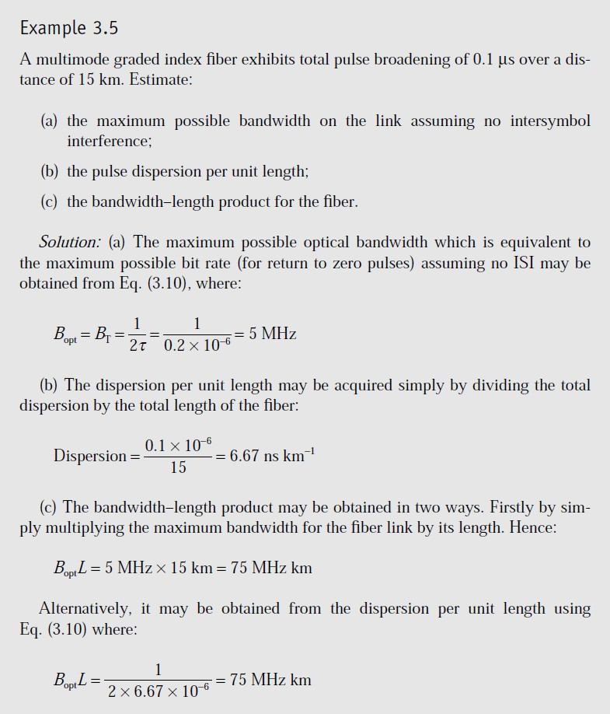
𝑩 (𝐦𝐚𝐱) =
𝟎. 𝟐
𝛔
𝐛𝐢𝐭 𝐒
−𝟏
(𝟑. 𝟏𝟑)
𝑻
Unlike the relationship given in Eq. (3.12), this analysis allows for the existence of a certain amount of signal overlap on the channel, while avoiding any SNR penalty which occurs when ISI becomes pronounced [1].

Slide 15
Lecture(8)
Chromatic dispersion
Chromatic or intramodal dispersion may occur in all types of optical fiber and results from the finite spectral line width of the optical source. Since optical sources do not emit just a single frequency but a band of frequencies (in the case of the injection laser corresponding to only a fraction of a percent of the center frequency, whereas for the LED it is likely to be a significant percentage), then there may be propagation delay differences between the different spectral components of the transmitted signal [1]. This causes broadening of each transmitted mode and hence intramodal dispersion. The delay differences may be caused by the dispersive properties of the waveguide material (material dispersion) and also guidance effects within the fiber structure (waveguide dispersion) [1].
1. Material dispersion
Pulse broadening due to material dispersion results from the different group velocities of the various spectral components launched into the fiber from the optical source. It occurs when the phase velocity of a plane wave propagating in the dielectric medium varies nonlinearly with wavelength, and a material is said to exhibit material dispersion when the second differential of the refractive index with respect to wavelength is not zero (i.e. d²n/dλ² ≠ 0) [1].
The material dispersion for optical fibers is sometimes quoted as a value for
|λ²(d²n1/dλ2) | or simply | d²n1/dλ² |. However, it may be given in terms of a material dispersion parameter M which is defined as [1]:
| 𝟏|
𝑴 =
𝟏 𝒅𝑻_{𝒎} 𝝀 𝒅𝒏^{𝟐}
=
ps nm⁻¹ km^{−1.}
(𝟑. 𝟏𝟒)
𝑳 𝒅𝝀 𝑪 𝒅𝝀^{𝟐}

Slide 16
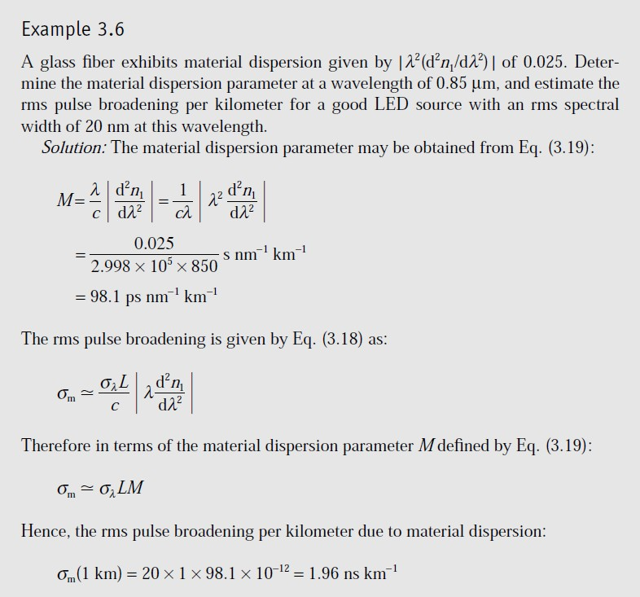
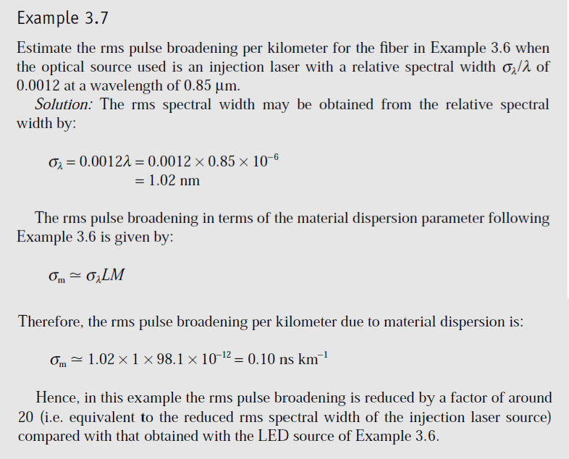

Slide 17
2. Waveguide dispersion
The wave guiding of the fiber may also create chromatic dispersion. This results from the variation in group velocity with wavelength for a particular mode. Considering the ray theory approach, it is equivalent to the angle between the ray and the fiber axis varying with wavelength which subsequently leads to a variation in the transmission times for the rays, and hence dispersion. For a single mode whose propagation constant is β, the fiber exhibits waveguide dispersion when d²β/dλ² ≠ 0 [1].

Slide 18
Lecture(9)
Intermodal dispersion
Pulse broadening due to intermodal dispersion (sometimes referred to simply as modal or mode dispersion) results from the propagation delay differences between modes within a multimode fiber. As the different modes which constitute a pulse in a multimode fiber travel along the channel at different group velocities, the pulse width at the output is dependent upon the transmission times of the slowest and fastest modes.
Thus multimode step index fibers exhibit a large amount of intermodal dispersion which gives the greatest pulse broadening. However, intermodal dispersion in multimode fibers may be reduced by adoption of an optimum refractive index profile which is provided by the near-parabolic profile of most graded index fibers. Under purely single-mode operation there is no intermodal dispersion and therefore pulse broadening is solely due to the intramodal(chromatic dispersion) dispersion mechanisms [1].
1. Multimode step index fiber
Using the ray theory model, the fastest and slowest modes propagating in the step index fiber may be represented by the axial ray and the extreme meridional ray (which is incident at the core–cladding interface at the critical angle φc) respectively. The paths taken by these two rays in a perfectly structured step index fiber are shown in Figure 3.11 [1].

Slide 19
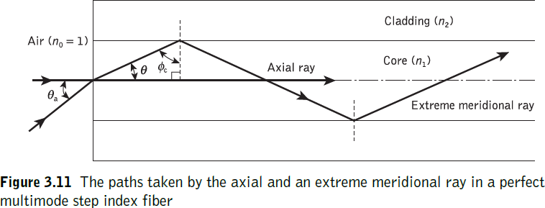
Hence the time taken for the axial ray to travel along a fiber of length L gives the minimum delay time TMin and [1]:
𝑻
𝒎𝒊𝒏
₌ 𝒅𝒊𝒔𝒕𝒂𝒏𝒄𝒆 ₌ 𝑳 ₌ 𝑳𝒏_{𝟏}
(3.15)
𝒗𝒆𝒍𝒐𝒔𝒊𝒕𝒚
𝑪
𝒏_{𝟏}
𝑪
where n1 is the refractive index of the core and c is the velocity of light in a vacuum. The extreme meridional ray exhibits the maximum delay time TMax where[1]:
𝑻
𝑳⁄
₌ 𝐜𝐨𝐬 𝜽 ₌ ^{𝑳𝒏}𝟏
(3.16)
𝒎𝒂𝒙 𝑪_{⁄𝒏}
𝟏
𝑪 𝐜𝐨𝐬 𝜽
Using Snell’s law of refraction at the core–cladding interface:
𝐬𝐢𝐧 ∅ = ^{𝒏𝟏} = 𝐜𝐨𝐬 𝜽 (3.17)
𝑪
𝒏_{𝟐}
where n2 is the refractive index of the cladding. Furthermore, substituting into Eq. (3.15) for cos θ gives:
𝑳𝒏^{𝟐}
∴𝑻_{𝒎𝒂𝒙} =
𝟏
𝑪𝒏_{𝟐}
(3.18)
The delay difference δTs between the extreme meridional ray and the axial ray may be obtained by subtracting Eq. (3.15) from Eq. (3.14). Hence:
𝒏𝑳 ^{𝟐} 𝑳𝒏_{𝟏}
δTs = TMax − TMin = ^{𝟏} −
𝑪𝒏_{𝟐} 𝑪
₌ 𝟏 ₍
𝑳𝒏^{𝟐} 𝒏_{𝟏}−𝒏_{𝟐}
)
𝑪𝒏_{𝟐} 𝒏_{𝟏}
𝑳𝒏^{𝟐} Δ
≃ 𝟏
𝑪𝒏_{𝟐}
Δ<< 1
(3.19)
∵ Δ = (
𝒏_{𝟏} − 𝒏_{𝟐}
)
𝒏_{𝟐}

Slide 20
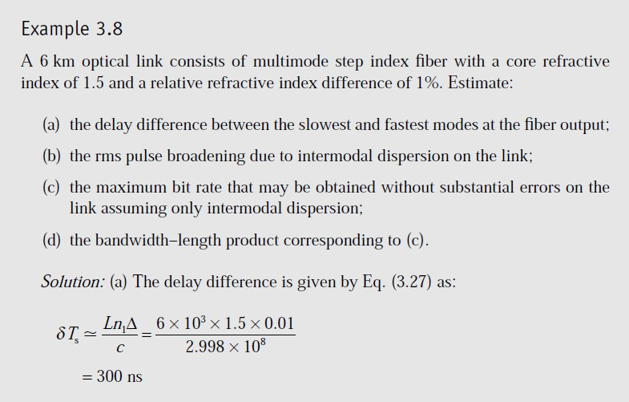
δTs = ^{𝑳𝒏𝟏} (^{𝒏𝟏−𝒏𝟐}) ≃ ^{𝑳𝒏𝟏} Δ
(3.20)
𝑪 𝒏_{𝟐}
𝑪
≃ 𝑳(𝑵𝑨)^{𝟐}
(3.21)
𝟐𝑪𝒏_{𝟏}
𝝆 ≃
𝑳𝒏_{𝟏 Δ ≃} 𝑳(𝑵𝑨)^{𝟐}
𝟐√𝟑 𝑪 𝟐√𝟑𝒏_{𝟏}𝑪
(3.22)
𝑺
Equation (3.22) allows estimation of the rms impulse response of a multimode step index fiber if it is assumed that intermodal dispersion dominates and there is a uniform distribution of light rays over the range 0 ≤ θ ≤ θa [1].

Slide 21
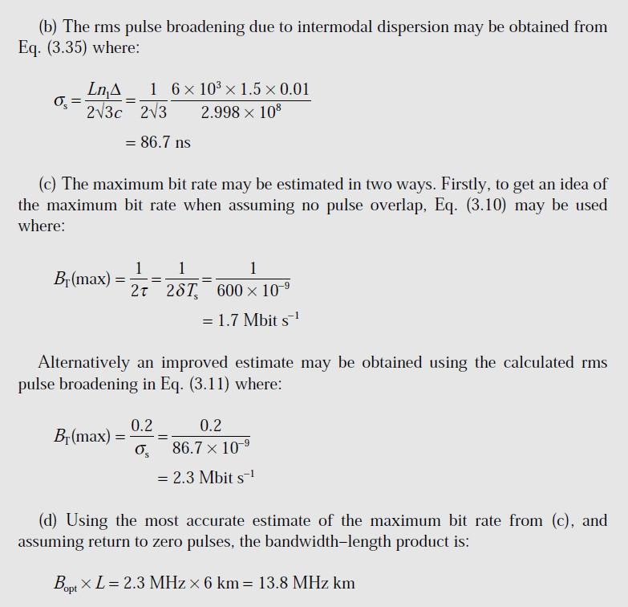

Slide 22
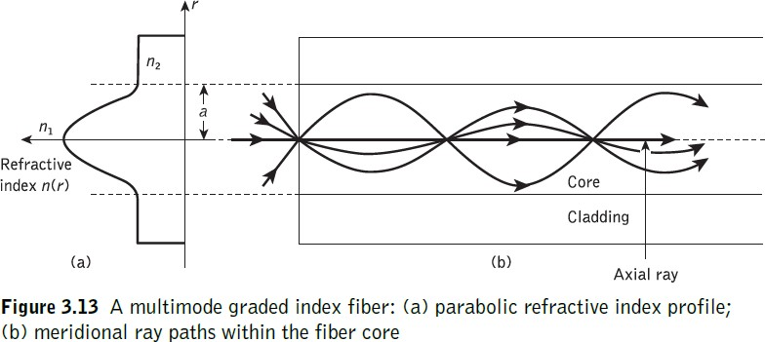
Lecture(10)
2. Multimode graded index fiber
Intermodal dispersion in multimode fibers is minimized with the use of graded index fibers. Hence, multimode graded index fibers show substantial bandwidth improvement over multimode step index fibers. The reason for the improved performance of graded index fibers may be observed by considering the ray diagram for a graded index fiber shown in Figure 3.13. The fiber shown has a parabolic index profile with a maximum at the core axis, as illustrated in Figure 3.13(a) and (b). Analytically, the index profile is given by Eq. (34) with α = 2 as [1] :
= n1[1 − 2Δ(r/a)²]^{1/2} r < a (core)
n(r)
= n1(1 − 2Δ)^{1/2} = n2 r ≥ a (cladding)
(3.23)
The dramatic improvement in multimode fiber bandwidth achieved with a parabolic or near-parabolic refractive index profile is highlighted by consideration of the reduced delay difference between the fastest and slowest modes for this graded index fiber δTg. Using aray theory approach the delay difference is given by[1]:
δ𝑻_{𝑺} ≃
𝑳𝒏_{𝟏}∆^{𝟐}
(𝑵𝑨)^{𝟐}
𝟐𝑪
≃ (𝟑. 𝟐𝟒)
𝟖𝑪𝒏^{𝟑}
𝟏
However, a more rigorous analysis using electromagnetic mode theory gives an absolute temporal width at the fiber output of [1]:

Slide 23
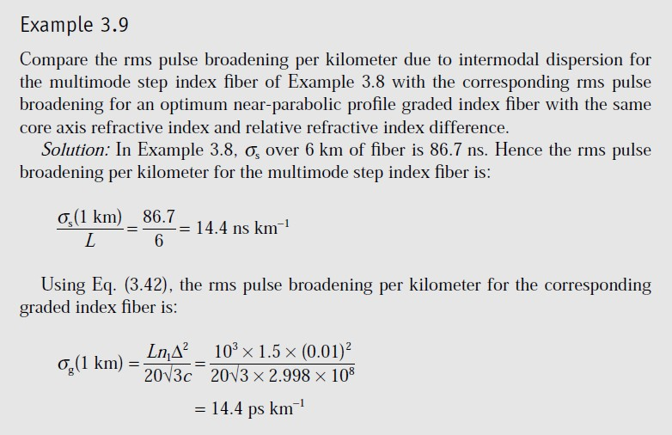
δ𝑻_{𝑺} ≃
𝑳𝒏_{𝟏}∆^{𝟐}
(𝟑. 𝟐𝟓)
𝟖𝑪
It may be shown that the rms pulse broadening of a near-parabolic index profile graded index fiber σg is reduced compared with similar broadening for the
corresponding step index fiber σs (i.e. with the same relative refractive index difference) following [1]:
∆
𝝈_{𝒈} = _{𝑫} 𝝈_{𝑺} (𝟑. 𝟐𝟔)
where D is a constant between 4 and 10 depending on the precise evaluation and the exact optimum profile chosen. The best minimum theoretical intermodal rms pulse broadening for a graded index fiber with an optimum characteristic refractive index profile for the core αop [1]:
𝟏𝟐Δ
𝜶_{𝒐𝒑} = 𝟐 − (𝟑. 𝟐𝟕)
𝟓
Thus the rms pulse boarding for graded index fiber is [1]:
𝝈_{𝒈} ≃
𝑳𝒏_{𝟏}∆^{𝟐}
(𝟑. 𝟐𝟖)
𝟐𝟎√𝟑𝑪

Slide 24
Modal noise
The intermodal dispersion properties of multimode optical fibers create another phenomenon which affects the transmitted signals on the optical channel. It is exhibited within the speckle patterns observed in multimode fiber as fluctuations which have characteristic times longer than the resolution time of the detector, and is known as modal or speckle noise. The speckle patterns are formed by the interference of the modes from a coherent source when the coherence time of the source is greater than the intermodal dispersion time δT within the fiber. The coherence time for a source with uncorrelated source frequency width δf is simply 1/δf. Hence, modal noise occurs when [1]:
δf ≫ ^{𝟏} (3.29)
δ𝑻
The conditions which give rise to modal noise are therefore specified as [1]:
a coherent source with a narrow spectral width and long coherence length (propagation velocity multiplied by the coherence time);
disturbances along the fiber which give differential mode delay or modal and spatial filtering;
phase correlation between the modes.
Modal noise may be avoided by removing one of the conditions (they must all be present) which give rise to this degradation [1].
The use of a broad spectrum source in order to eliminate the modal interference effects. This may be achieved by either (a) increasing the width of the single longitudinal mode and hence decreasing its coherence time or (b) by increasing the number of longitudinal modes and averaging out of the interference patterns[1].
In conjunction with 1(b) it is found that fibers with large numerical apertures support the transmission of a large number of modes giving a greater number of speckles, and hence reduce the modal noise generating effect of individual speckles [1].
The use of single-mode fiber which does not support the transmission of different modes and thus there is no intermodal interference[1].

Slide 25
The removal of disturbances along the fiber. This has been investigated with regard to connector design [Ref. 42] in order to reduce the shift in speckle pattern induced by mechanical vibration and fiber misalignment[1].
Reference:
  John M. Senior, Book "Optical Fiber Communications Principles and Practice" Pearson prentice Hall, Third edition published 2009.

